Slide 1

(Sales Analysis)
Hrishik Verma

Slide 2
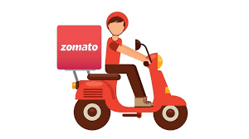
Zomato: An Introduction
An online food delivery and restaurant discovery platform that operates across multiple countries.
Founded in India in 2008, Zomato has grown to become one of the largest food aggregators globally.
The platform's user-friendly interface and extensive database of eateries cater to diverse culinary preferences, from local street food to upscale dining.
Beyond food delivery, Zomato also provides restaurant management software and advertising solutions for businesses.

Slide 3
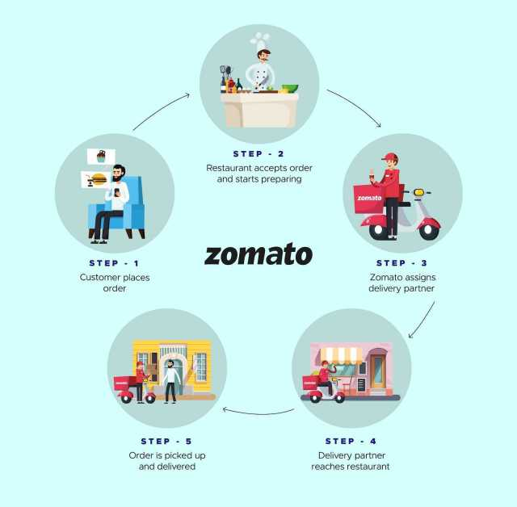
The Zomato Workflow

Slide 4
Dataset Overview
Total # of restaurants: 9551

